Slide 1

ALY6980 – Capstone Project Presentation - Predictive Analysis of Bitcoin Hash rate
Date: 08/22/2023
Presented by: Group 3
Vishaka Mohan Mohana
Sakthi Pradeepa Muthukumar
Shraddha Reddy Panyala
Richa Umesh Rambhia
Mohan Samala

Slide 2
Executive Summary
Marathon Digital Holdings, a pioneer in the cryptocurrency mining sector, understands the critical relevance of Bitcoin's hashrate volatility, which is a vital measure of the network's processing power.
Develop a precise predictive model to analyze Bitcoin's hashrate volatility, aiding Marathon Digital Holdings in strategic decision-making for mining operations.
Utilize a comprehensive dataset to explore the relationships between parameters like block height, timestamp, and reward fees, uncovering insights into hashrate changes.
Enhance Bitcoin network's stability and support Marathon Digital Holdings with data-driven decisions, optimizing mining strategies in response to dynamic market conditions.
Marathon Digital Holdings' commitment to understanding hashrate fluctuations paves the way for innovative mining practices and operational efficiency in the cryptocurrency sector.

Slide 3
Business Problem
Business Problem
Marathon Digital Holdings is facing the difficulty of understanding and forecasting fluctuation in Bitcoin's intraday hashrate.
Challenge 1:
Understand Bitcoin Hashrate Volatility
Challenge 2:
Develop an Accurate Predictive Model

Slide 4

Data Preparation
We considered the dataset provided in below link for our analysis from 13- May 2023 to 15-August 2023: https://chain.api.btc.com/v3/block/date/20230705
The dataset was in JSON format. Therefore, it was converted to CSV format for loading the set to the Jupyter Notebook and Tableau platforms.
There are 16 numerical variables and 6 categorical variables with 13909 rows in the dataset available for analysis.

Slide 5
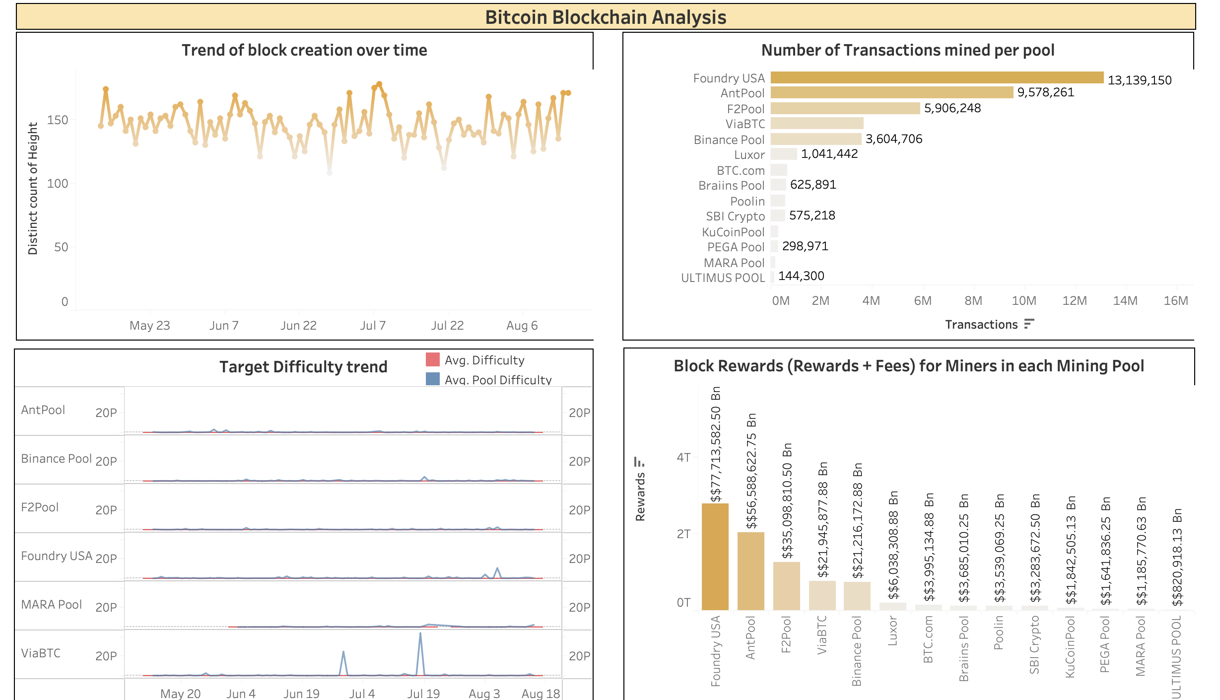
Data Exploration and Analytics
Trend of Block Creation: Analyze timestamp and height to identify patterns and fluctuations in block mining rate over time, indicating changes in mining activity or network congestion.
Transactions per Mining Pool: Visualize tx_count and extras/poolname to assess distribution of transactions among mining pools, revealing decentralization or concentration of mining power.
Block Rewards Analysis: Examine block rewards using 'Reward Block' and 'extras/poolname' to understand profitability and competitiveness of mining pools.
Target Difficulty Trend: Visualize difficulty,’ pool_difficulty,' and 'timestamp' to gain insights into how the mining pool's difficulty level aligns with the network-wide difficulty.

Slide 6
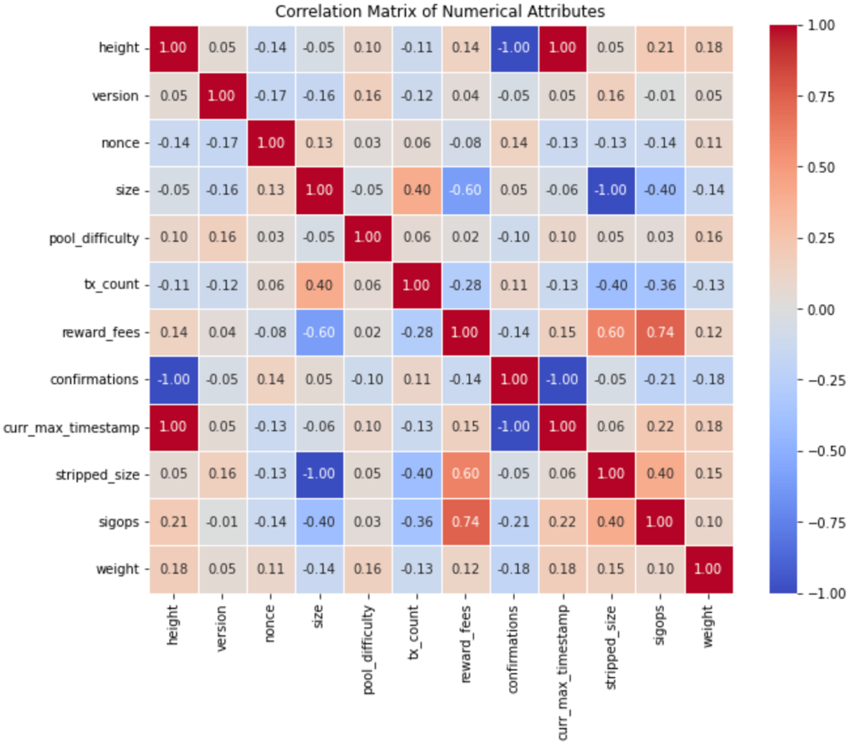
Data Exploration and Analytics
Correlation Matrix across Numerical Variables
The "sigops" and "stripped_size" qualities strongly positively correlate with the "reward_fees" property. This shows that incentive fees are likely to rise along with the number of signature procedures and stripped size.
Additionally, there is a significant positive connection between the "size" and "transaction_count" attributes, showing that larger transactions often have more transactions. The "size" attribute has the least association with the "stripped_size" attribute, while the "height" attribute has the least correlation with "confirmations," respectively.

Slide 7
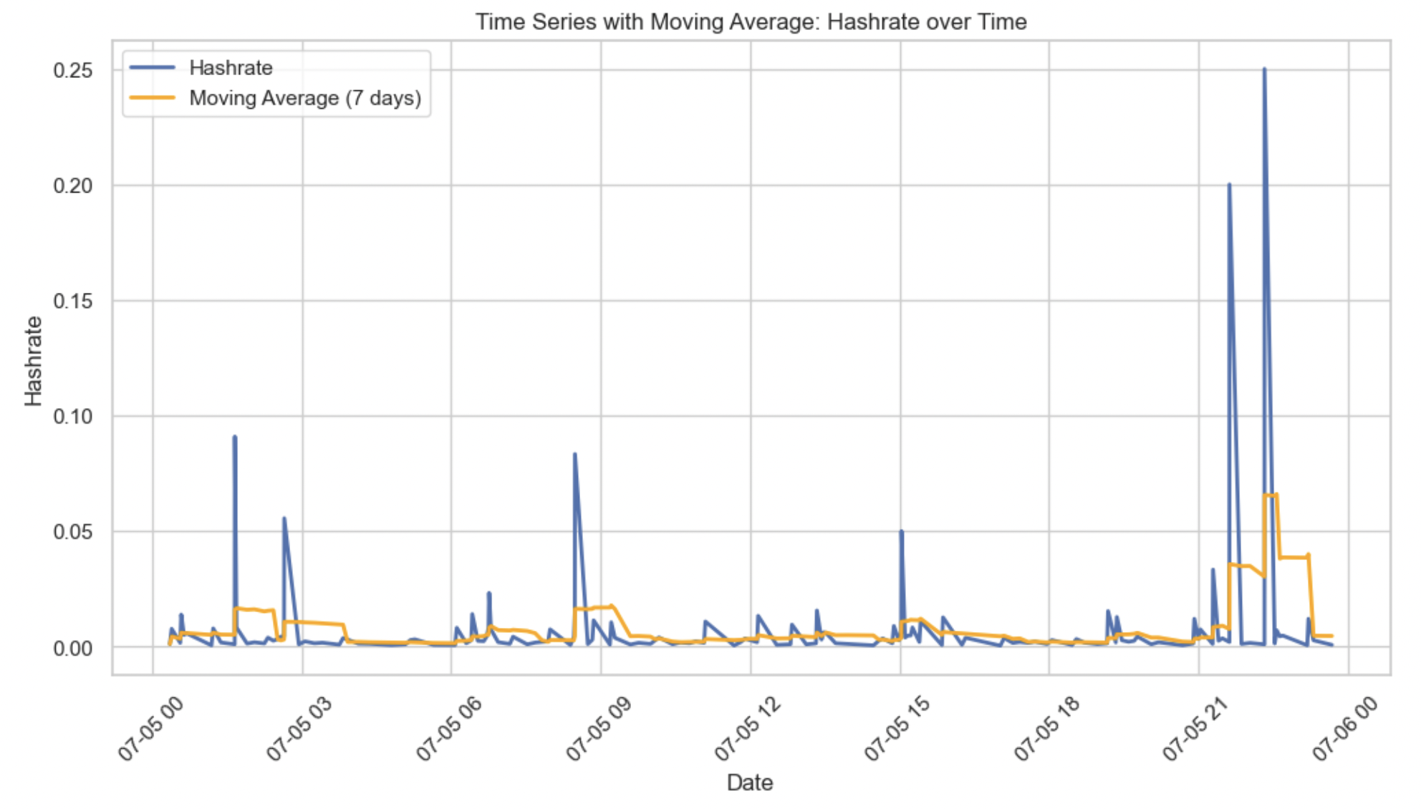
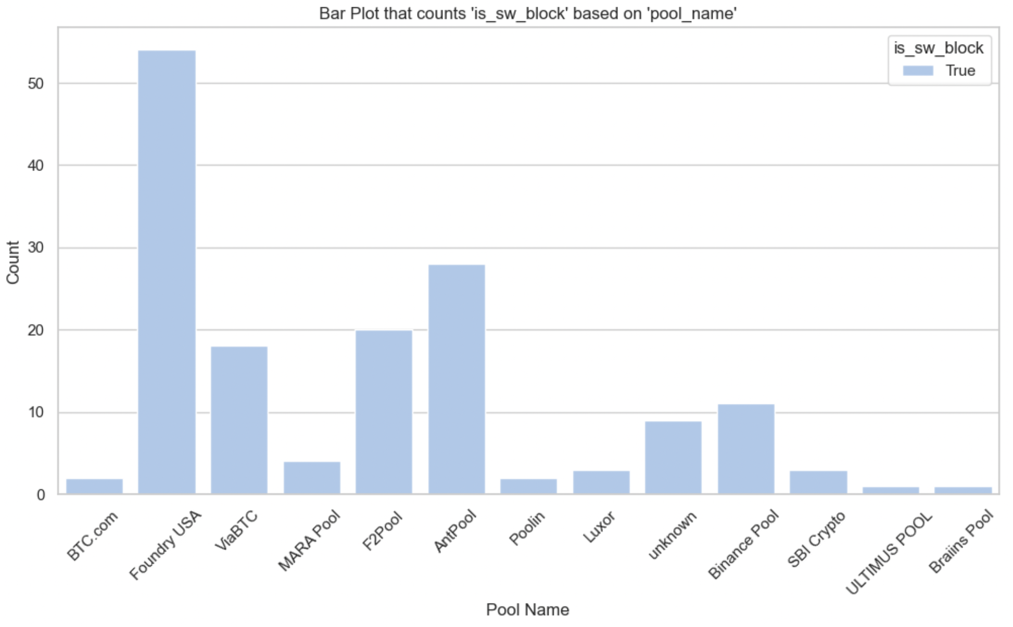
This technique allows investors in technical analysis to smoothening out the volatility of changing hash rate. It helps in long-term prediction.
Data Exploration and Analytics
From the analysis, we can identify that Foundry USA has highest count, which indicates that most of the transaction are happening in this mining pool.

Slide 8
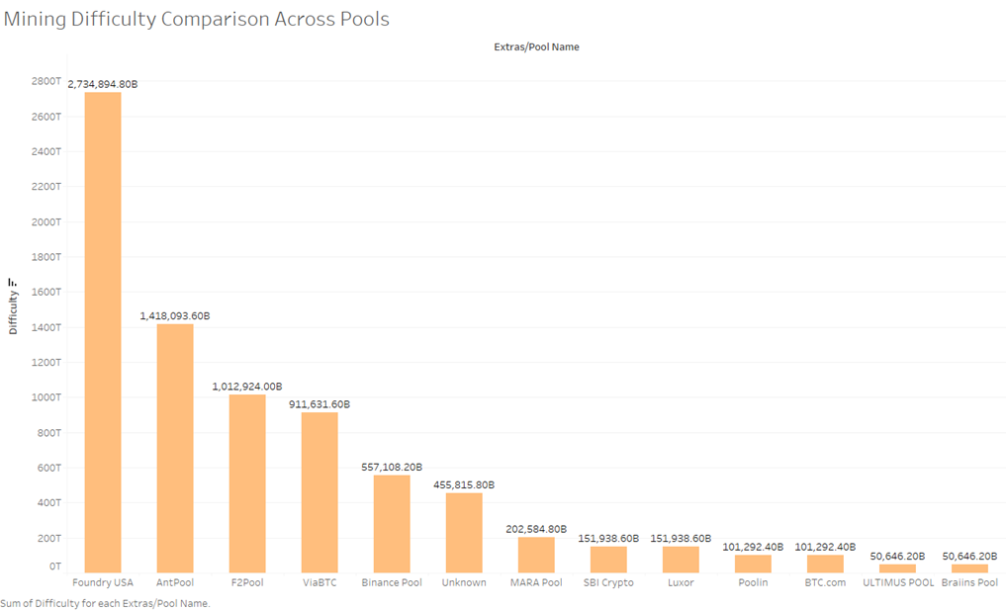
Mining Difficulty Comparison Across Pools
Data Exploration and Analytics
The graph compares the mining difficulty of different pools, showing the range of difficulty values across various pools.
We can observe that the difficulty values are spread across different scales, indicating variations in mining power and hash rates among the pools.
The graph also shows the distribution of mining difficulty across different pools. It provides insights into how mining power is distributed among various pools, highlighting potential centralization or decentralization of mining efforts.

Slide 9
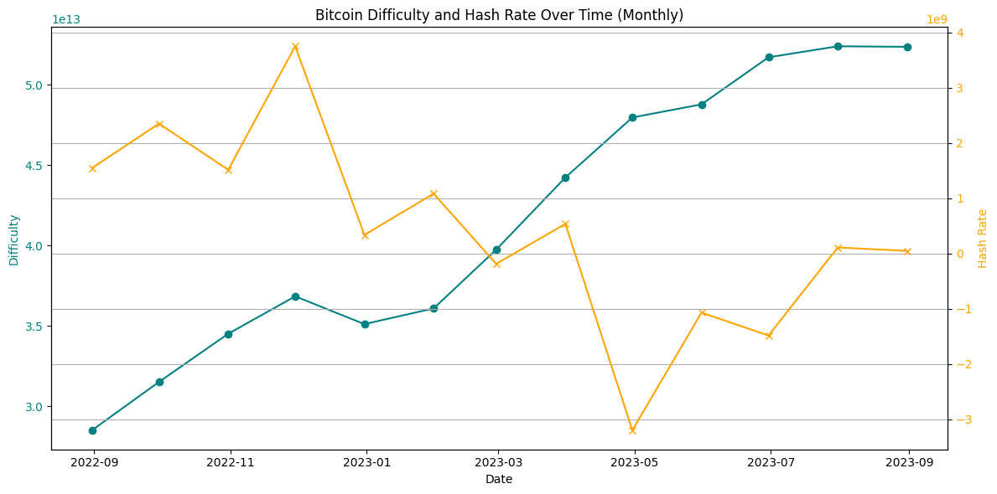
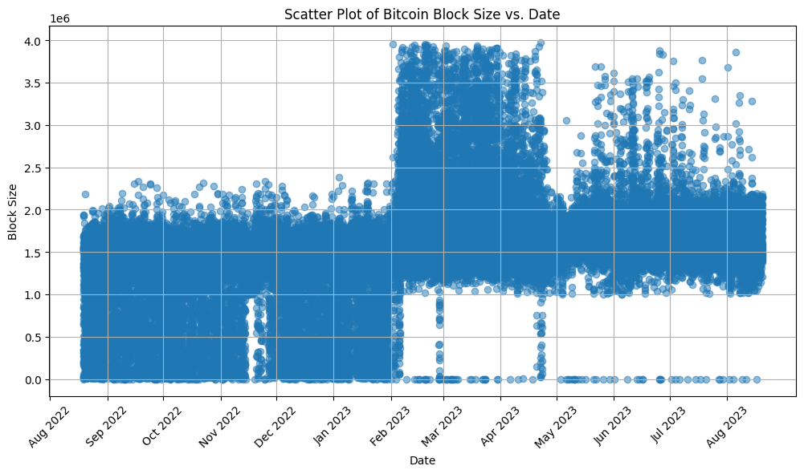
Data Exploration and Analytics
Enhanced Line Plot for Bitcoin Difficulty & Hashrate:
Enhanced monthly line plot is vital for predictive modeling.
Identifies trends, simplifies interpretation, and emphasizes events.
Scatter Plot of Bitcoin Block Size:
Block size scatter plot reveals trends and larger sizes at specific times.
Aids protocol analysis and understanding of performance.

Slide 10
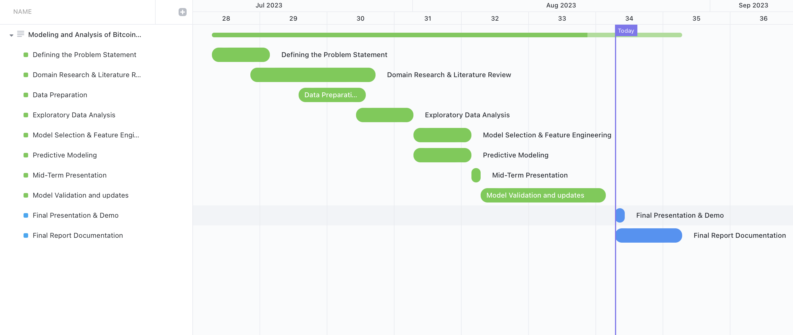
Project Flow
The project roadmap defines essential milestones and tasks to achieve research objectives.
Emphasis on iterative feedback loops and continuous improvement for enhanced predictive capabilities.
Ensuring model relevance in the evolving cryptocurrency landscape.
Enhancing understanding of Bitcoin hashrate fluctuations and contributing to the cryptocurrency ecosystem.
Supporting Marathon Digital Holdings in making informed decisions for long-term success in the dynamic Bitcoin market.

Slide 11
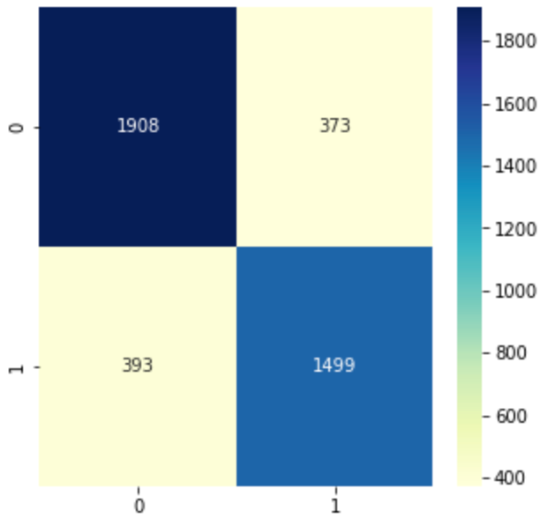
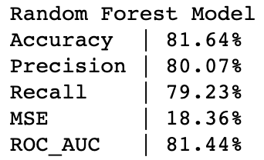
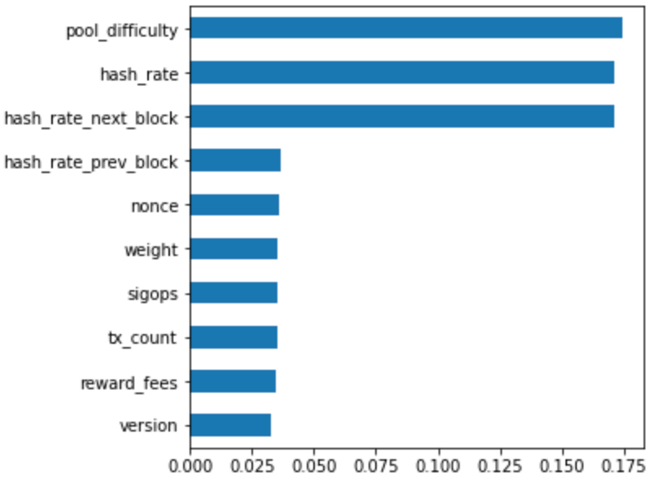
Predictive Modeling – Random Forest
The Random Forest model has demonstrated an accuracy of approximately 81.64% in predicting hash rate increases.
These metrics indicate the model's balanced performance in correctly identifying instances of hash rate increases and minimizing both false positives and false negatives.
With a Mean Squared Error (MSE) of 18.36%, the model's predictions closely align with actual numerical values.
The Receiver Operating Characteristic Area Under Curve (ROC_AUC) score of 81.44% underscores the model's exceptional ability to distinguish between instances of hash rate increases and non-increases.
The feature importance analysis reveals key attributes driving hash rate predictions. Notably, attributes such as "hash_rate_next_block," "pool_difficulty," and "hash_rate" hold substantial importance.

Slide 12
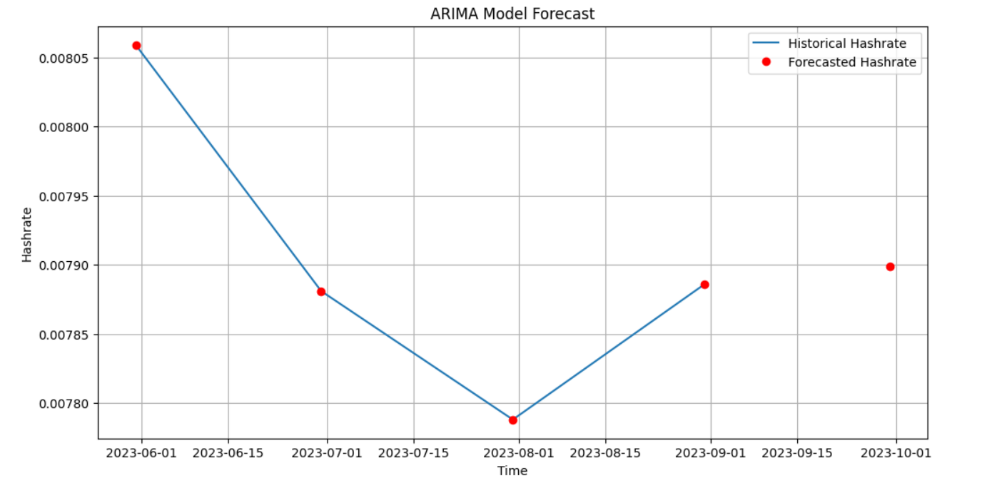
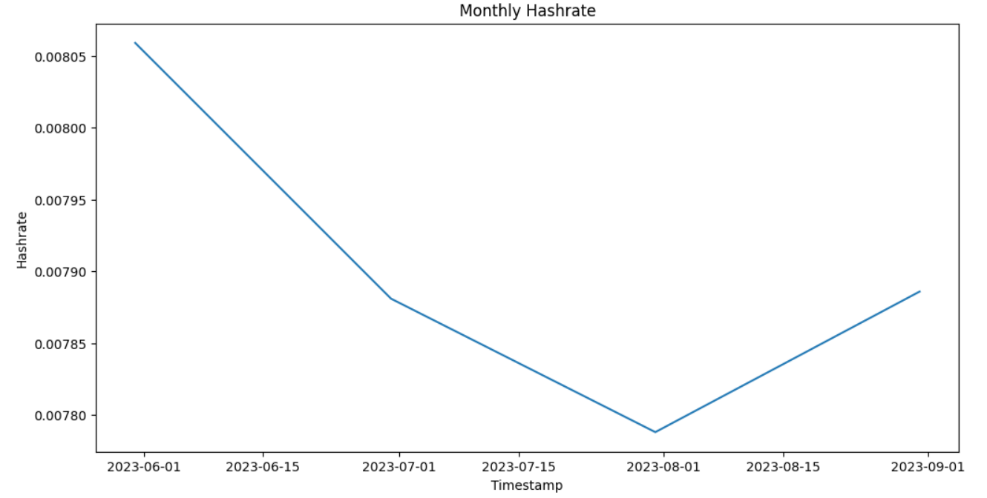
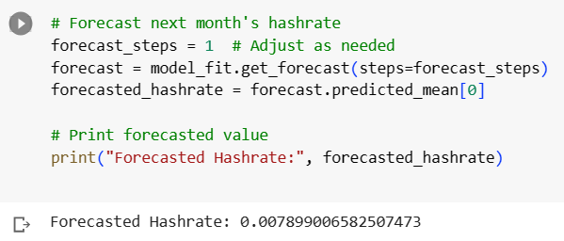
Predictive Modeling – ARIMA Model
The plotted graph provides a visual representation of the monthly hash rate trend over time.
The line plot shows the historical monthly hash rate data as a continuous line and the forecasted hash rate as a red circle at the predicted point.
The red circle indicates the forecasted hash rate for the next month based on the ARIMA model's simple average prediction.
This visualization provides a clear representation of the model's forecasted value in the context of the historical data, aiding in understanding the model's performance and the predicted trend.

Slide 13
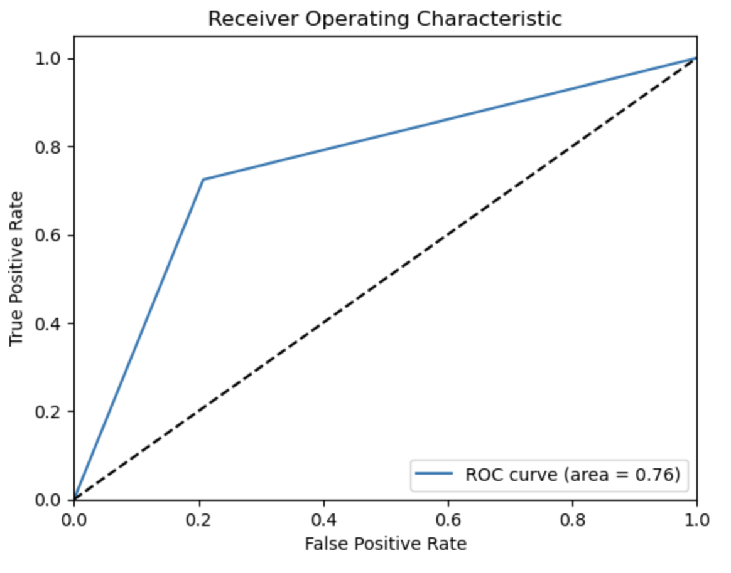
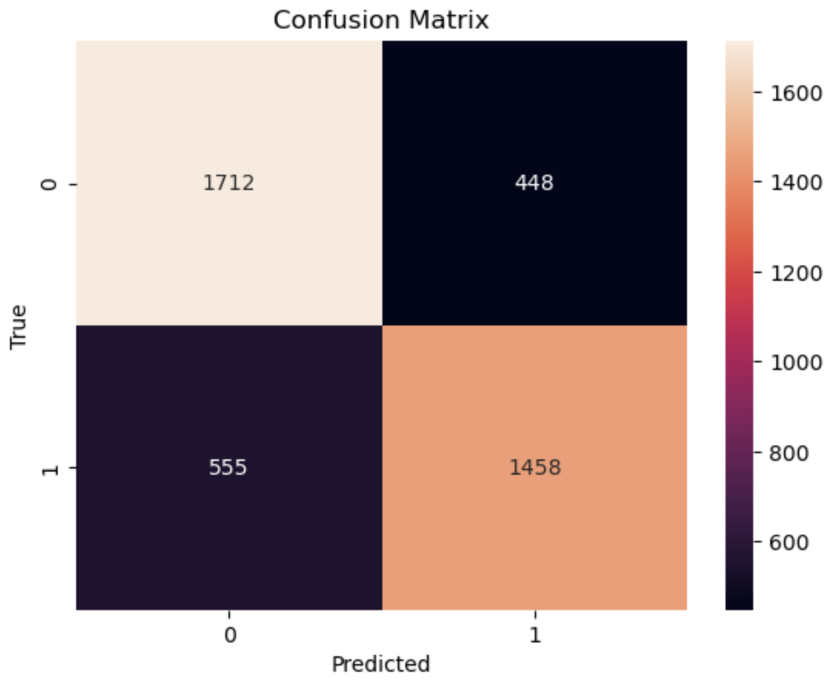
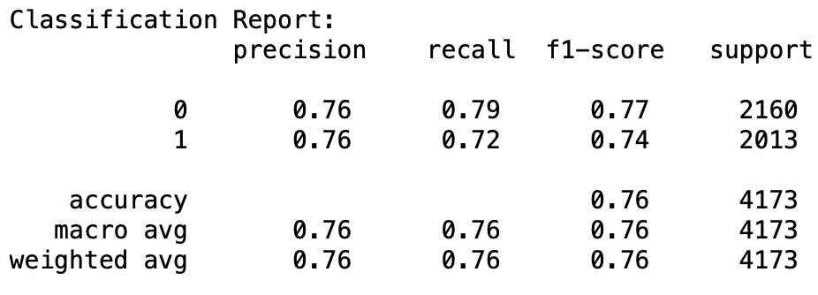
Predictive Modeling - Gradient Boost Classifier
The developed Gradient Boosting Classifier model achieved an accuracy of 75.96%, showcasing its ability to make accurate predictions.
The balanced performance metrics, such as precision, recall, and F1-score, demonstrate the model's effectiveness in capturing both positive and negative instances.

Slide 14
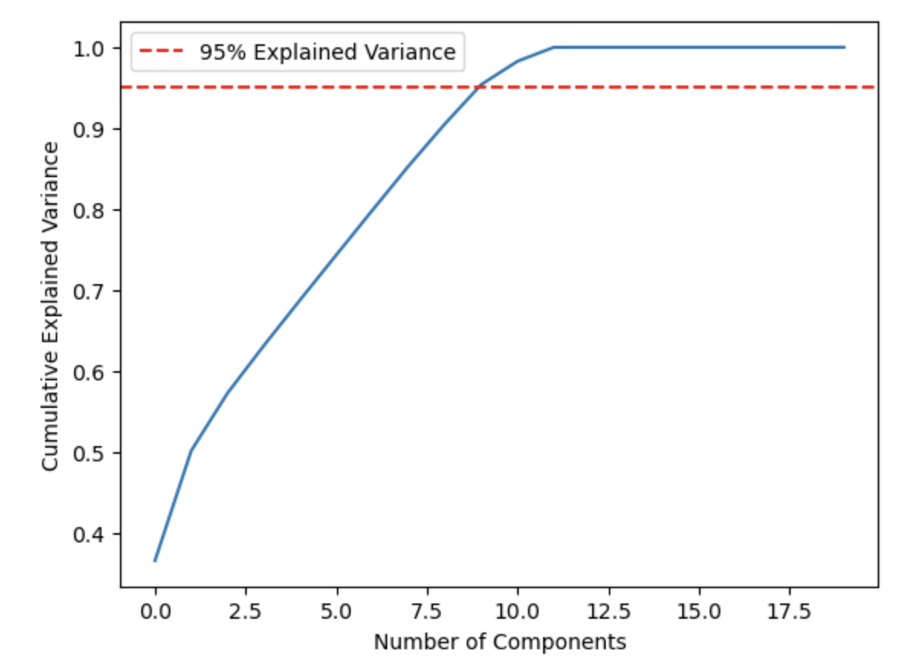
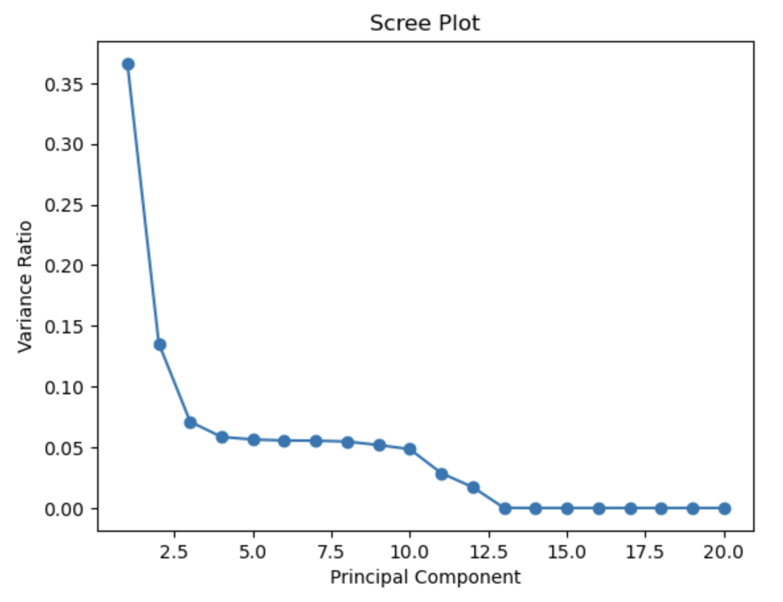
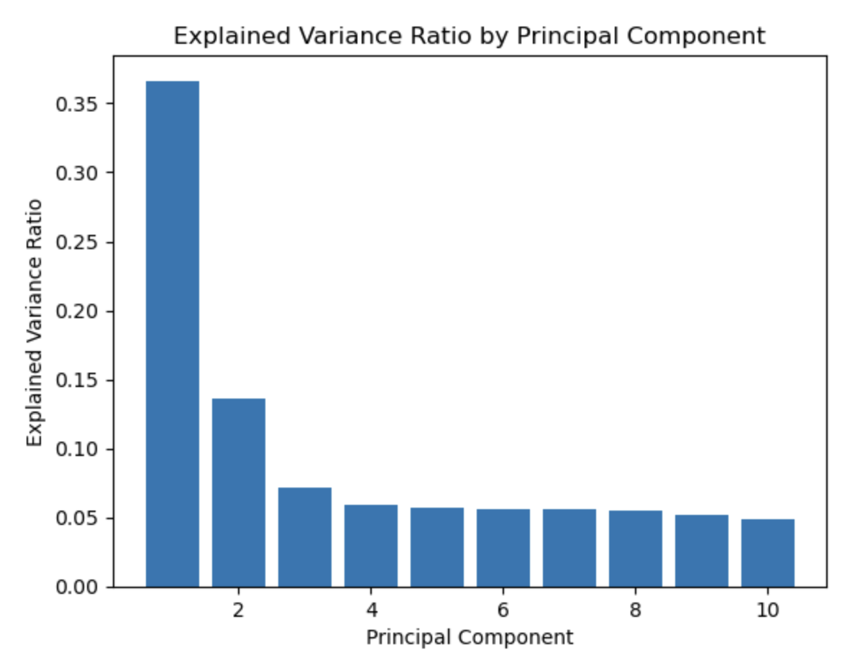
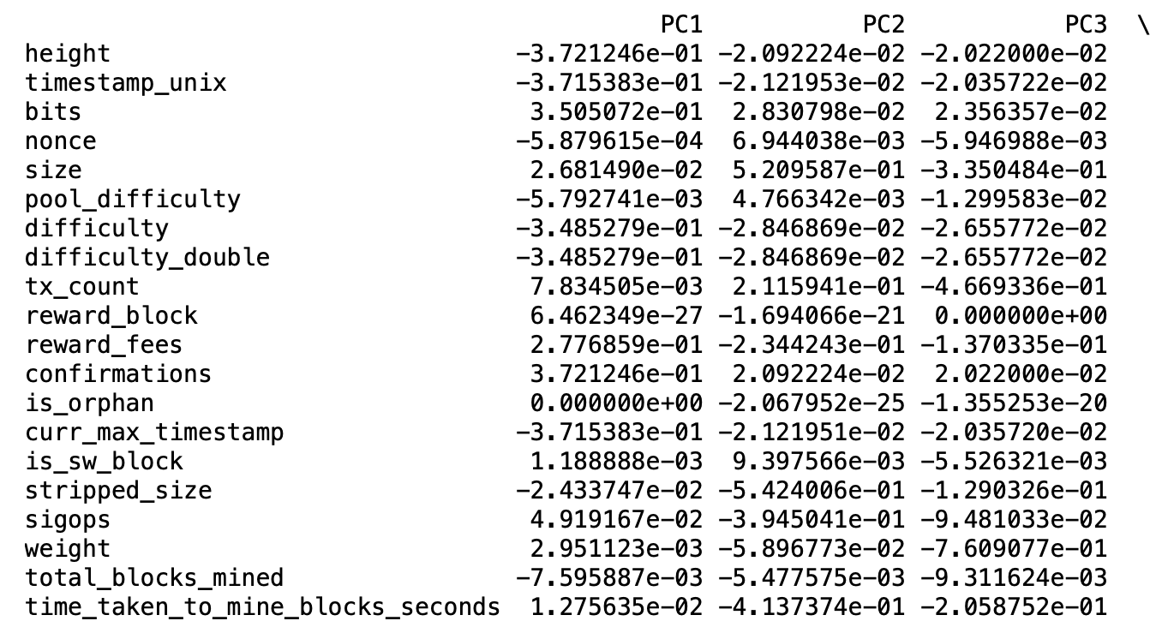
Predictive Modeling - PCA
PC1: Attributes related to block height, timestamp, difficulty, size, reward fees, and confirmation show positive correlation with PC1.
PC2: Attributes like nonce, size, tx_count, stripped_size, and sigops influence PC2. Larger transactions and specific operational attributes appear to cause a decrease in the value of PC2.
PC3: Attributes bits, pool_difficulty, and weight contribute to PC3. Higher values of these attributes are associated with lower values of PC3, indicating an inverse relationship.
PC4 to PC10: These components involve more complex relationships and patterns. For instance, PC4 is influenced by a combination of attributes like nonce, pool_difficulty, and difficulty, suggesting they might share common trends.

Slide 15
Future Research
Dynamic Predictive Model: Enhance the predictive model with real-time data and advanced machine learning techniques for adaptive and accurate hashrate predictions.
Influence of Regulatory Changes: Investigate how legal and regulatory shifts impact Bitcoin hashrate, analyzing correlations between regulatory announcements and hashrate fluctuations.
Environmental Considerations: Examine the environmental impact of Bitcoin mining, assess carbon footprint, and promote sustainable practices within mining operations.
Market Sentiment Analysis: Integrate sentiment analysis of social media and news to understand how public perception shapes hashrate variations.
Security and Attack Resilience: Study Bitcoin network resilience against attacks (e.g., 51% attacks) and model potential impacts on hashrate dynamics for enhanced security.
The ongoing evolution of cryptocurrency and blockchain technology presents numerous opportunities for future research, spanning diverse areas.
This section highlights key research domains that can enhance our comprehension of Bitcoin's hashrate dynamics and its wider consequences.
Researchers and practitioners engaging in these topics can refine predictive models, offer regulatory insights, promote environmental sustainability, analyze market sentiment, and bolster security measures, enriching Bitcoin mining's scope and impact.

Slide 16

Conclusion
The project aimed to analyze and predict Bitcoin's hash rate fluctuations through EDA and a predictive model, revealing insights into influencing factors.
The Random Forest model effectively predicted hash rate increases with balanced precision and recall, aligned with error distribution.
The ARIMA model was utilized to forecast the hash rate, and its predictions were visualized to provide insights into the expected future trends of the hash rate.
The model's low MSE indicated close prediction-real value alignment, while its ROC_AUC score highlighted class differentiation capability.
From the Principal Component Analysis, PC1 shows attributes positively correlated and increasing together, PC2 associates with certain attributes decreasing PC2's value. PC3 associates higher attribute values with lower PC3 values. Other PCs are combinations of attributes, revealing correlations or irrelevance.
Using the Gradient Boost Classifier, the model achieved an overall accuracy of 76%, with balanced precision, recall, and F1-score values for both classes, highlighting its consistent performance across the binary classification task.
Further enhancements, diverse metrics, and validation are needed for improved utility and dependability, considering domain expertise and contextual understanding.

Slide 17
References
Lumerin Protocol (2022, July 25). Hashrate Explained: A Critical Aspect for Bitcoin’s Security. Medium. Retrieved from: https://medium.com/lumerin-blog/what-is-hashrate-a80271af40ac
Oliveira, Marcio (2021, September 12). Applying Linear Regression on Bitcoin’s historical data. Medium. Retrieved from: https://medium.com/coinmonks/applying-linear-regression-on-bitcoins-historical-data-94d986010283
Nilshmeier. (2022). Bitcoin EDA - Exploratory Data Analysis. Kaggle. Retrieved from: https://www.kaggle.com/code/nilshmeier/bitcoin-eda-exploratory-data-analysis/notebook
GeeksforGeeks. (2022b). Bitcoin Price Prediction using Machine Learning in Python. GeeksforGeeks. Retrieved from: https://www.geeksforgeeks.org/bitcoin-price-prediction-using-machine-learning-in-python/
Chen, J. (2023) Analysis of bitcoin price prediction using machine learning, MDPI. Available at: https://www.mdpi.com/1911-8074/16/1/51 (Accessed: 24 July 2023).

Slide 18
Thank You

Slide 19
APPENDIX: Individual Project Contributions and Proposals
The project tasks such as domain research, literature review, data preparation and exploratory data analysis, were meticulously divided among all team members, ensuring balanced distribution of responsibilities, which facilitated efficient collaboration and contributed to the overall success of the project.
For future tasks, such as predictive modeling and analysis, the team will continue to adhere to the same approach of task distribution among all team members, fostering a collaborative environment that promotes efficiency, and collective success in our endeavors.

Slide 20
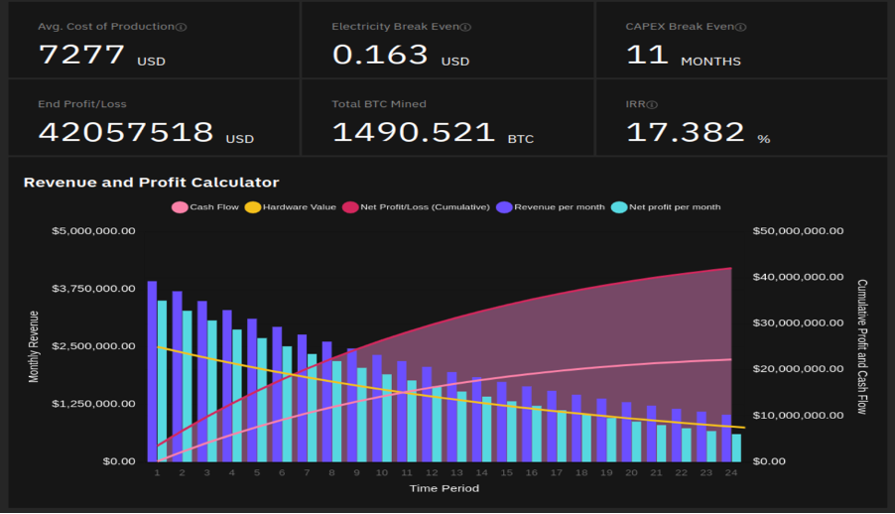
Individual project: Prediction of Bitcoin Revenue and Profit
The primary focus of this project is on predictive modeling, although data visualization and dashboarding may aid in exploratory data analysis and identifying trends in the data.
The ultimate goal is to develop a robust model that can not only explain the causes behind hashrate fluctuations but also accurately predict future variations.
By achieving this objective, the research will provide valuable insights for Marathon Digital Holdings and other stakeholders, enabling a better understanding of the dynamics of Bitcoin hashrate and potentially uncovering any intentional manipulation or other factors affecting the hashrate.
The dashboard created for the project will assist in visualizing the relationships between various variables in the dataset, further enhancing the understanding of the data and its implications for the Bitcoin hashrate.
Author: Vishaka Mohan Mohana

Slide 21
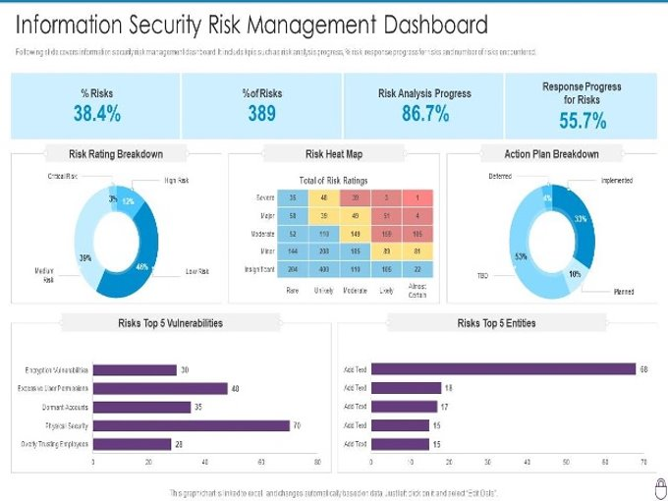
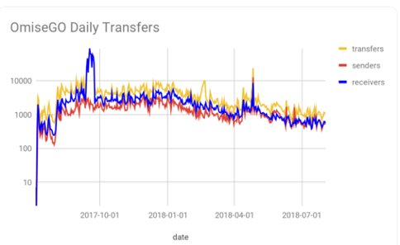
Individual project : Blockchain Security Assessment and Risk Mitigation
Project Objective: Evaluating Marathon's blockchain infrastructure security and devising proactive measures to safeguard their valuable Bitcoin holdings from potential threats.
Transactions
Dashboard
Author : Mohan Samala

Slide 22
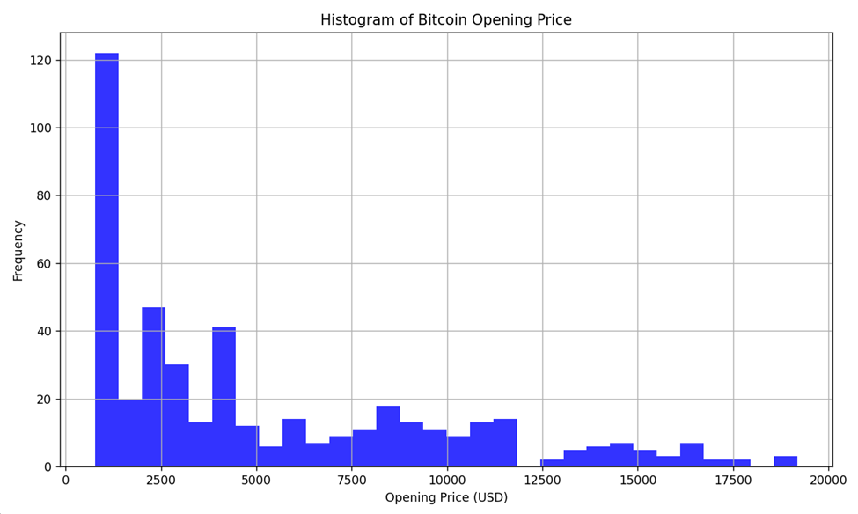
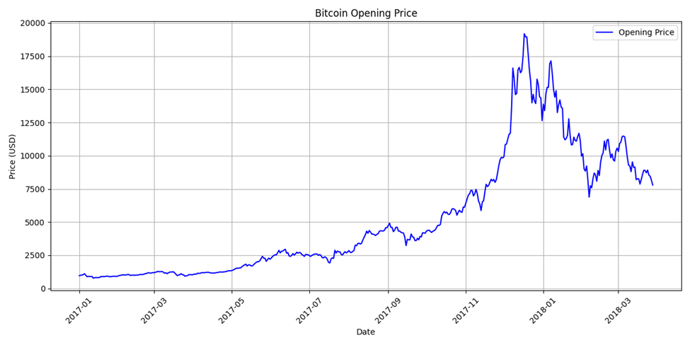
Individual Project : Optimizing Bitcoin Mining Strategies through a Hybrid Analytical Approach: Data-Driven Insights for Efficiency, Sustainability, and Profitability
Project Objective:
The objective of this project is to identify and develop an optimal Bitcoin mining strategy by employing a hybrid analytical approach that integrates quantitative analysis, machine learning optimization, and qualitative insights.
The aim is to provide evidence-based recommendations and tools that enhance the efficiency, sustainability, and profitability of Bitcoin mining operations, while also addressing data governance, ethical considerations, social responsibility, and effective business leadership within the cryptocurrency mining landscape.
Author : Richa Umesh Rambhia

Slide 23
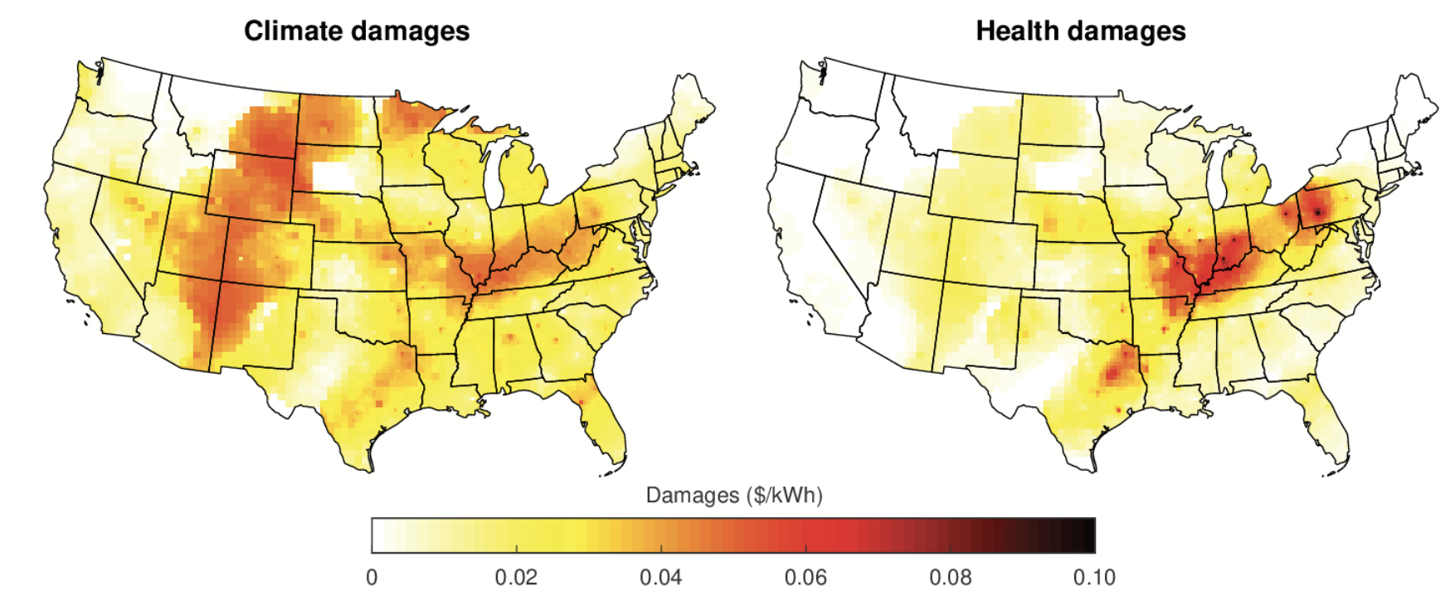
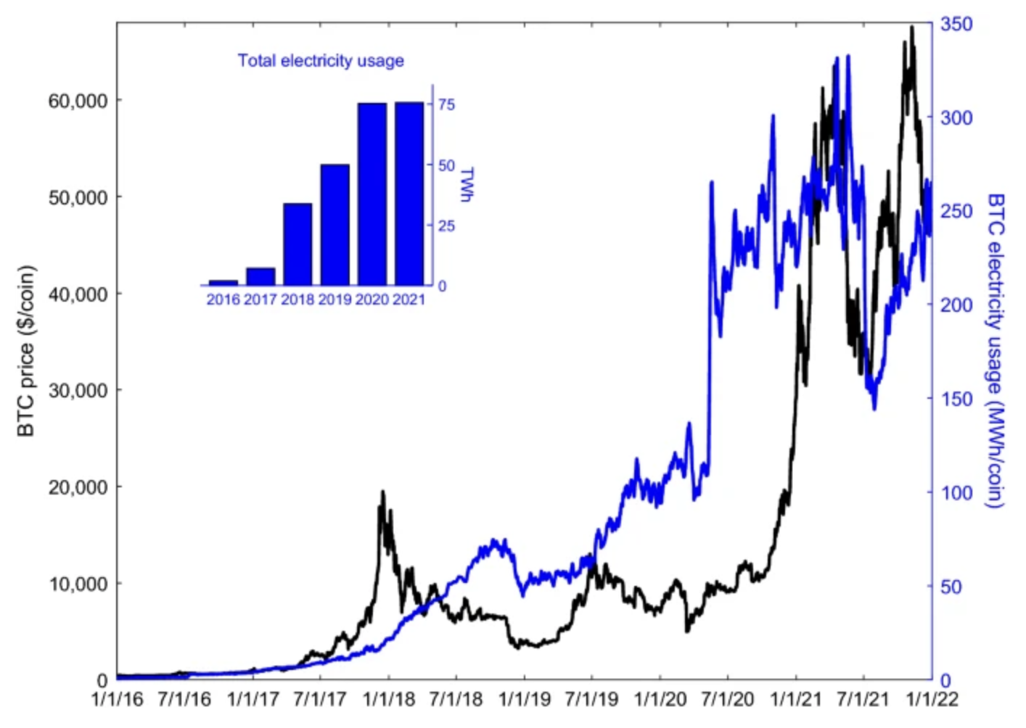
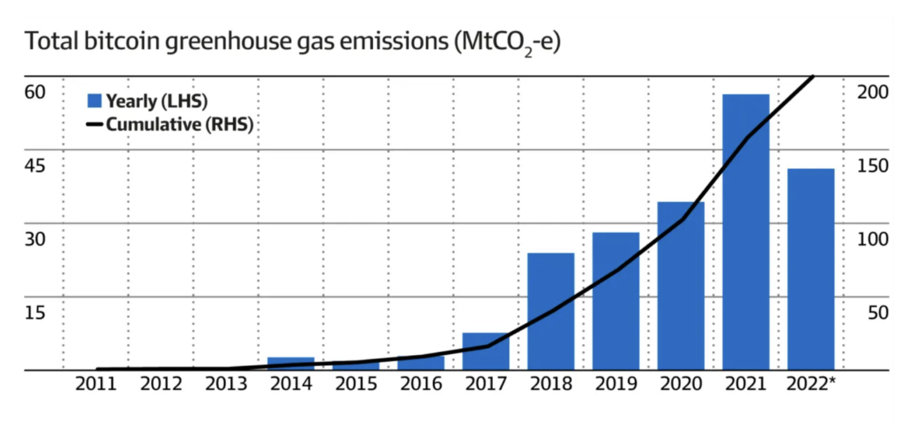
Bitcoin Mining-Unveiling its Climate Damages
Objective: Conduct a comprehensive economic estimation of the climate damages caused by Bitcoin mining. This will involve quantifying the carbon footprint, greenhouse gas emissions, and other environmental impacts associated with the energy-intensive mining process.
Author: Shraddha Reddy

Slide 24
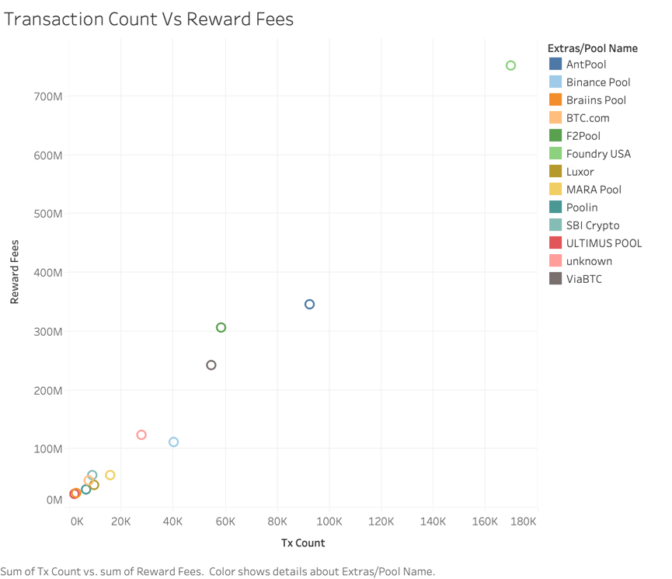
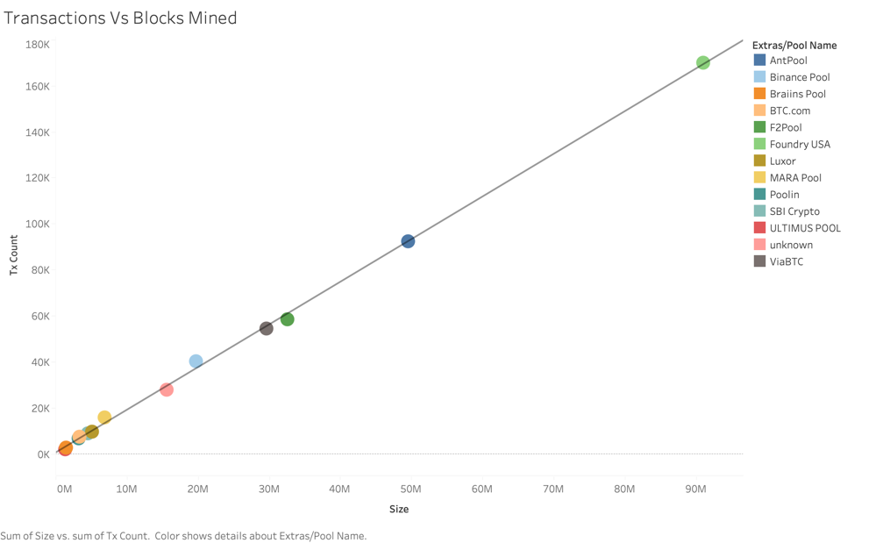
Principal Component Analysis of Bitcoin Hashrate
The objective of the project is to develop a predictive model using principal component analysis to forecast the unexplained variance in hashrate.
Principal component analysis (PCA) will enable extraction of essential features from high-dimensional datasets. By reducing the dimensionality, PCA will help us identify the most critical components driving hashrate variability and enable us to build a more efficient and accurate predictive model.
Author: Sakthi Pradeepa Muthukumar

